Slide 1
CIVL 4210 - Advanced Construction with AI and Robotics Guidebook: Setup a python environment for machine learning
Prof. Yu
HUANG Xuhong
The Hong Kong University of Science and Technology (HKUST)

Slide 2

Unlocking the Power of Google Colab
Google Colab is a free, cloud-based platform that provides a complete python environment for machine learning and data analysis projects.
This guidebook will show you how to get started.

Slide 3
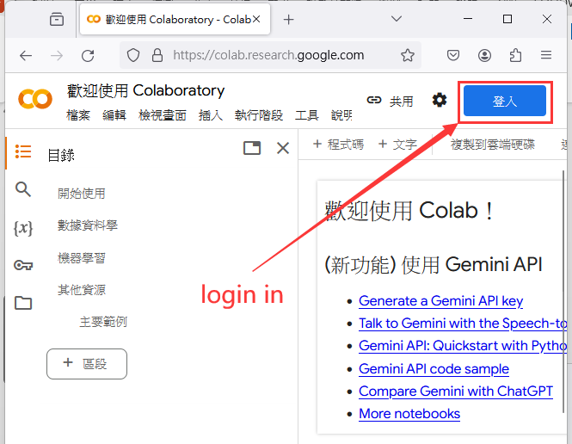

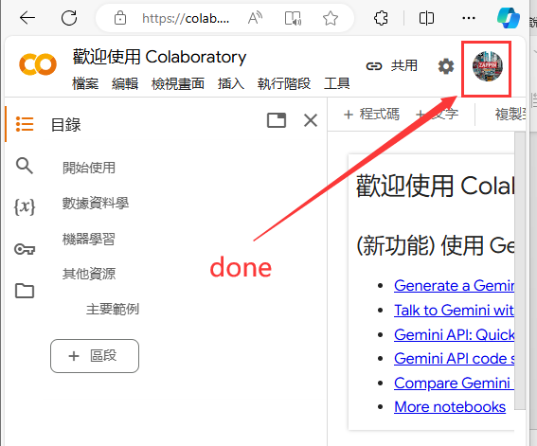
Step 1: Creating Your Account
1
Open Google Colab
2
Access with Email
3
Complete Registration
Open the Google Colab website (https://colab.research.google.com/).
Google Colab is fully integrated with Gmail, so you can easily sign in and start using it right away.
Once you're signed in, follow the simple steps to complete your registration and start using Google Colab.

Slide 4
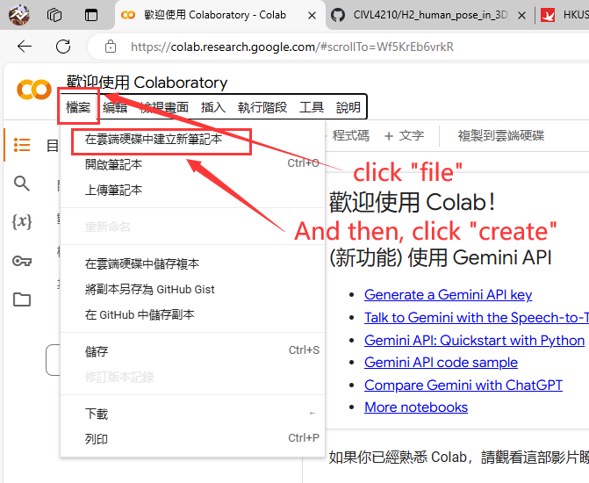
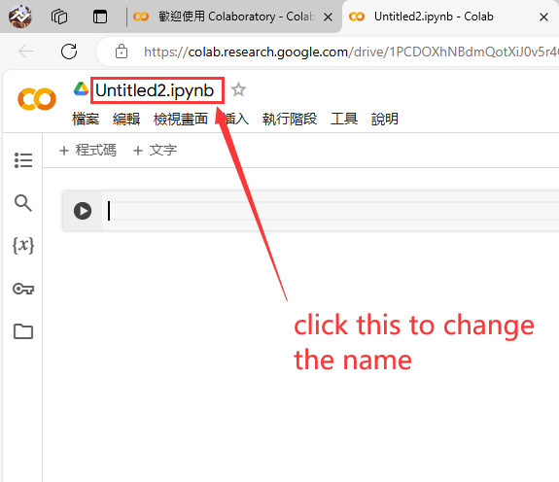
Step 2: Creating a New Notebook
Step 2.1: Click on "New Notebook"
Step 2.2: Give your notebook a name
In the dashboard, click on the "New Notebook" button to create a new Colab notebook.
A dialog box will appear asking you to provide a name for your notebook. Enter a descriptive name that reflects the purpose of your project.

Slide 5
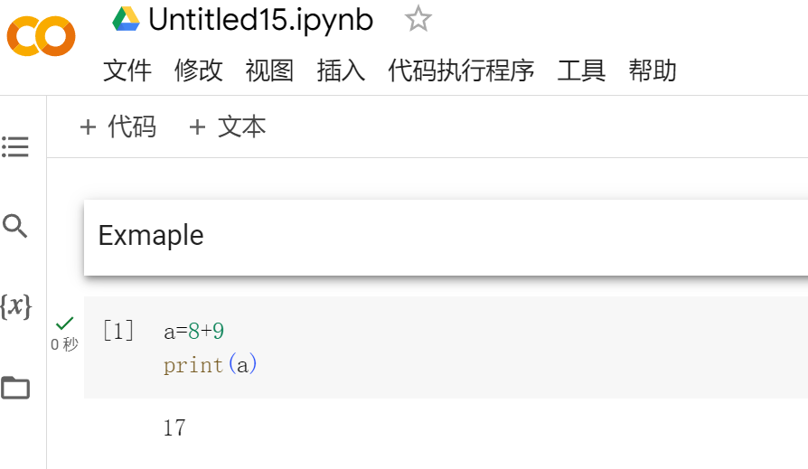
Understanding the Colab Interface
1
2
3
Menu bar
Code cell
Text cell
It contains various options for managing and running your notebook, such as saving, running code cells, and changing runtime settings.
This is where you can write and run Python code. Each code cell can be run individually.
You can add text explanations or notice using text cells. They are useful for providing instructions or adding comments to your code

Slide 6
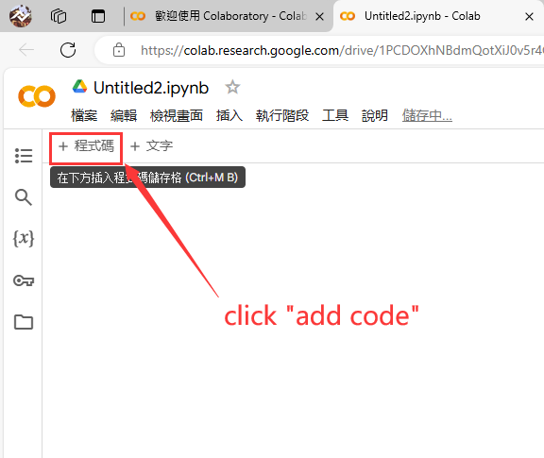
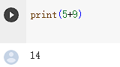
Step 3: Writing and Running Code
Step 1：Adding a code cell
Step 2：Writing your code
Step 3：Run the code cell
To add a code cell, simply click on the "+" button in the toolbar.
In the code cell, you can write your Python code.
For example
we add 5+9, and we print the rtesult.
print(5+9)
you can click the play button.

Slide 7
Other Methods for Creating a New Notebook
Start from Scratch
Open Existing Notebook
Import form Github
Create a new, blank notebook in Google Colab by accessing the Notebook menu.
If you already have a notebook, you can easily open it in Google Colab by selecting it from your files.
Google Colab makes it easy to import existing notebooks from online websites, for example Github.

Slide 8
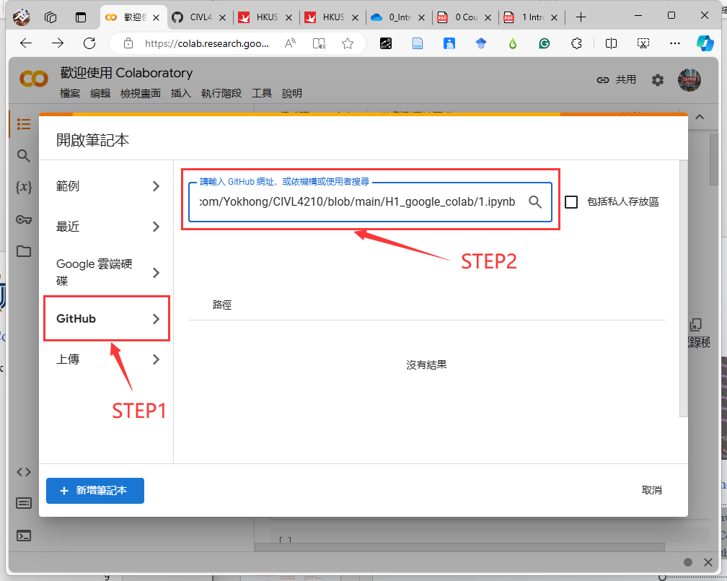
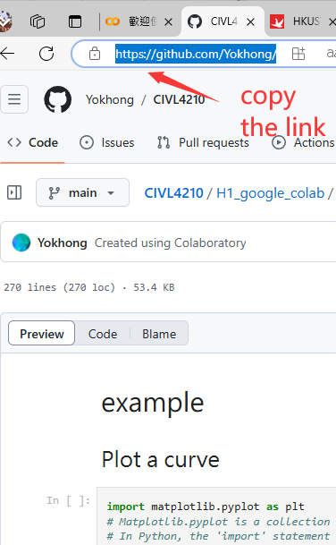
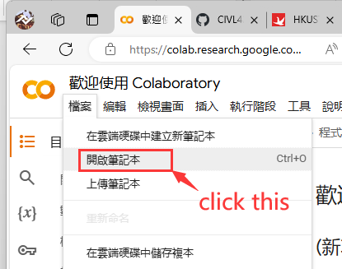
Import form Github
Finding the Code on GitHub
Copying the Repository Link
Open the Colab
Visit the GitHub website (github.com).
Search for the code repository provided for this lesson.
https://github.com/Yokhong/CIVL4210/
Once you have found the repository, locate the "Code" button and click on it. Copy the link.
Open this link from google colab.

Slide 9
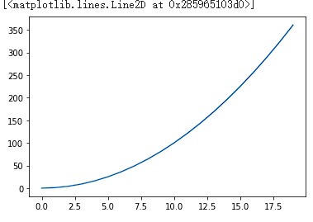
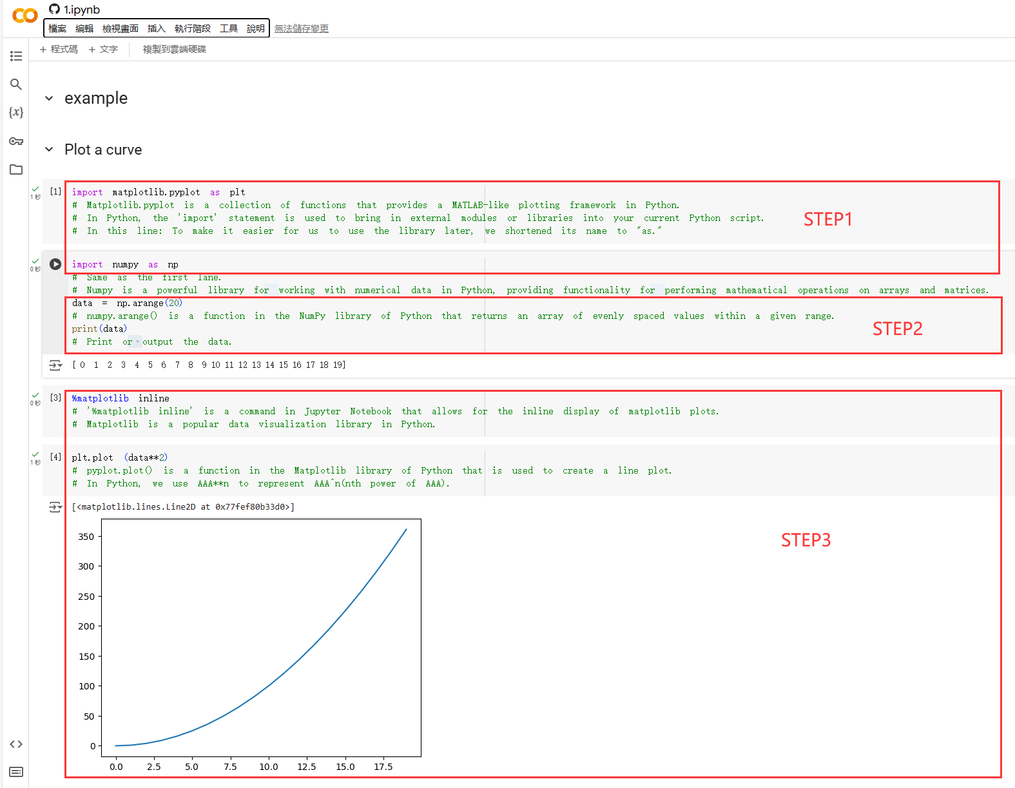
Running Code in Google Colab
Step 1：Import model
Step 2：Creat array
Step 3：Draw the squares of array
import matplotlib.pyplot as plt
import numpy as np
data = np.arange(20)
print(data)
plt.plot (data**2)
https://github.com/Yokhong/CIVL4210/blob/main/H1_google_colab/1.ipynb

Slide 10
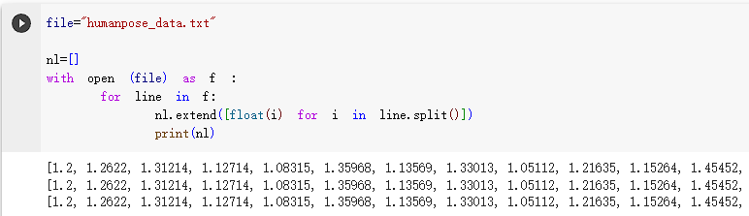
Running Code in Google Colab
Code cell
Text cell
file="humanpose_data.txt"
nl=[]
with open (file) as f :
for line in f:
nl.extend([float(i) for i in line.split()])
print(nl)
First we need to define our file path so that the program can find our file.
We're creating an empty array to hold our data.
Next we use the OPEN model to read each line of our file and then output it.
We can output our data.
Different data require reading and output methods, here we only carried out the txt method.

